Slide 1

Software Project Management
Dr. Sumaira Nazir
Department of Software Engineering
National University of Modern Languages, Islamabad

Slide 2
Program and Project Portfolio Management

Slide 3
Program
A program is “a group of related projects.
Program activities managed in a coordinated manner to obtain benefits and control not available from managing them individually.
It is often more economical to group projects together to help streamline management, staffing, purchasing, and other work.
Programs are not large projects; a megaproject is a very large project that typically costs over US$1 billion, affects over one million people, and lasts several years.

Slide 4
Program cont.
Example
Infrastructure:
An IT department often has a program for IT infrastructure projects. This program could encompass several projects, such as providing more wireless Internet access, upgrading hardware and software, enhancing computer security, and developing and maintaining corporate standards for IT
User support:
In addition to the many operational tasks related to user support, many IT departments have several projects to support users. For example, a project might provide a better e-mail system or develop technical training for users

Slide 5
Program Manager
A program manager
Provides leadership and direction for the project managers heading the projects within a program.
coordinate the efforts of project teams, functional groups, suppliers, and operations staff supporting the projects
to ensure that products and processes are implemented to maximize benefits.

Slide 6
Program Manager Cont.
Program managers are responsible for more than the delivery of project results
They are change agents responsible for the success of products and processes developed by those projects.

Slide 7
Program Manager Cont.
Program managers often have review meetings with all their project managers to share important information and coordinate important aspects of each project.
Many program managers worked as project managers earlier in their careers, and they enjoy sharing their wisdom and expertise with their project managers.

Slide 8

Program Manager Cont.
Effective program managers recognize that managing a program is much more complex than managing a single project.
They recognize that technical and project management skills are not enough—program managers must also possess strong business knowledge, leadership capabilities, and communication skills

Slide 9

Project Portfolio Management
In many organizations, project managers also support an emerging business strategy of project portfolio management or portfolio management,
in which organizations group and manage projects and programs as a portfolio of investments that contribute to the entire enterprise’s success.

Slide 10
Project Portfolio Management
Project portfolio management (PPM) refers to
a process used by project managers to analyze the potential return on undertaking a project. Project portfolio management gives organizations and managers the ability to see the big picture.

Slide 11

Project Portfolio Management Cont.
Portfolio managers help their organizations make wise investment decisions by helping to select and analyze projects from a strategic perspective.
Portfolio managers may or may not have previous experience as project or program managers.
It is most important that they have strong financial and analytical skills and understand how projects and programs can contribute to meeting strategic goals

Slide 12
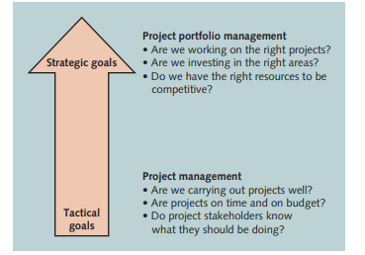
Figure 3 Project management compared to project portfolio management

Slide 13
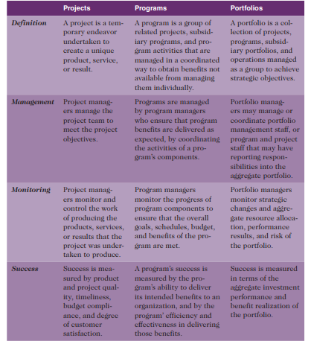
Comparative Overview of Portfolios, Programs, and Projects

Slide 14
Role , Responsibilities and Skills of Project Manager

Slide 15

Project Manager Job Description
A project manager can have many different job descriptions, which can vary tremendously based on the organization, but most project managers perform similar tasks regardless of these differences
Project management jobs can be found in every country and every industry

Slide 16
Project Manager Job Description Cont.
Project manager for a consulting firm:
Plans, schedules, and controls activities to fulfill identified objectives applying technical, theoretical, and managerial skills to satisfy project requirements. Coordinates and integrates team and individual efforts and builds positive professional relationships with clients and associates.

Slide 17
Project Manager Job Description Cont.
Project manager for a computer systems firm:
Assist in the development and implementation process of projects involving departmental, vendor relationships, and/or cross-functional teams. Coordinates with internal/external clients to gather business requirements and coordinate project plans. Monitor projects from initiation through delivery ensuring completion of the project on schedule.

Slide 18
Project Manager Job Description Cont.
Project manager for a computer systems firm:
Assist in the development and implementation process of projects involving departmental, vendor relationships, and/or cross-functional teams. Coordinates with internal/external clients to gather business requirements and coordinate project plans. Monitor projects from initiation through delivery ensuring completion of the project on schedule.

Slide 19
Skills for Project Manager
Project managers need to have a wide variety of skills and be able to decide which skills are more important in different situations
The project environment differs from organization to organization and project to project, but some skills will help in almost all project environments.

Slide 20
Skills for Project Manager cont.
These skills include
understanding change and understanding how organizations work within their social, political, and physical environments.
Project managers must be comfortable leading and handling change, because most projects introduce changes in organizations and involve changes within the projects themselves.
Project managers need to understand the organization in which they work and how that organization develops products and provides services

Slide 21
Skills for Project Manager cont.
Project managers should also possess general management knowledge and skills.
They should understand important topics related to
financial management, accounting, procurement, sales, marketing, contracts, manufacturing, distribution, logistics, the supply chain, strategic planning, tactical planning, operations management, organizational structures and behavior, personnel administration, compensation, benefits, career paths, and health and safety practices.

